Slide 1
BigData Minor

Slide 2
Introduction to Big Data & Basic Data Analysis

Slide 3
Data
Data
Big Data
Big data is predicted to transform almost everything about how we live our lives.
From healthcare to finance,
from advertising to entertainment,
unprecedented amounts of data are being generated and stored,
So skilled professionals are needed to analyze that data for important insights and fill positions in the growing tech sector.

Slide 4

Big Data EveryWhere!
Lots of data is being collected and warehoused
Web data, e-commerce
purchases at department/ grocery stores
Bank/Credit Card transactions
Social Network

Slide 5
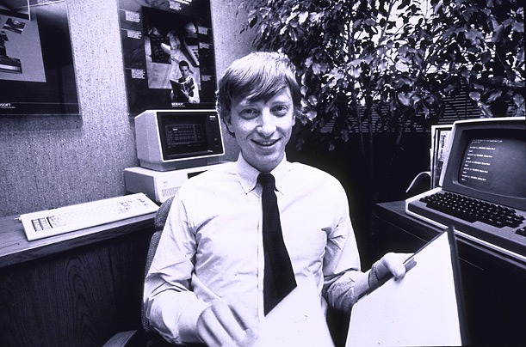
How much data?
Google processes 20 PB a day (2008)
Wayback Machine has 3 PB + 100 TB/month (3/2009)
Facebook has 2.5 PB of user data + 15 TB/day (4/2009)
eBay has 6.5 PB of user data + 50 TB/day (5/2009)
CERN’s Large Hydron Collider (LHC) generates 15 PB a year
640K ought to be enough for anybody.

Slide 6
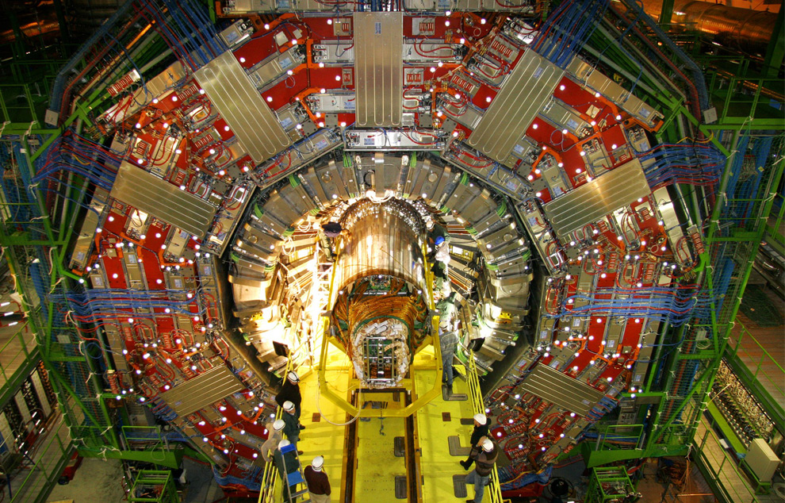
Maximilien Brice, © CERN

Slide 7
Type of Data
Relational Data (Tables/Transaction/Legacy Data)
Text Data (Web)
Semi-structured Data (XML)
Graph Data
Social Network, Semantic Web (RDF), …
Streaming Data
You can only scan the data once

Slide 8
What to do with these data?
Aggregation and Statistics
Data warehouse and OLAP
Indexing, Searching, and Querying
Keyword based search
Pattern matching (XML/RDF)
Knowledge discovery
Data Mining
Statistical Modeling

Slide 9
1. Tracking Customer Spending Habit, Shopping Behavior
1. Tracking Customer Spending Habit, Shopping Behavior:
In big retails store (like Amazon, Walmart, Big Bazar etc.) management team has to keep data of
customer’s spending habit (in which product customer spent, in which band they wish to spent, how frequently they spent),
shopping behavior,
customer’s most liked product (so that they can keep those products in the store).
Which product is being searched/sold most, based on that data, production/collection rate of that product get fixed.
Banking sector uses their customer’s spending behavior-related data so that they can provide the offer to a particular customer to buy his particular liked product by using bank’s credit or debit card with discount or cashback.
By this way, they can send the right offer to the right person at the right time.

Slide 10
2. Recommendation
2. Recommendation: By tracking customer spending habit, shopping behavior, Big retails store provide a recommendation to the customer. E-commerce site like Amazon, Walmart, Flipkart does product recommendation. They track what product a customer is searching, based on that data they recommend that type of product to that customer.
As an example, suppose any customer searched bed cover on Amazon. So, Amazon got data that customer may be interested to buy bed cover. Next time when that customer will go to any google page, advertisement of various bed covers will be seen. Thus, advertisement of the right product to the right customer can be sent.
YouTube also shows recommend video based on user’s previous liked, watched video type. Based on the content of a video, the user is watching, relevant advertisement is shown during video running.
As an example suppose someone watching a tutorial video of Big data, then advertisement of some other big data course will be shown during that video.

Slide 11
3. Smart Traffic System
3. Smart Traffic System:
Data about the condition of the traffic of different road, collected through camera kept beside the road, at entry and exit point of the city, GPS device placed in the vehicle (Ola, Uber cab, etc.).
All such data are analyzed and jam-free or less jam way, less time taking ways are recommended.
Such a way smart traffic system can be built in the city by Big data analysis.
One more profit is fuel consumption can be reduced.

Slide 12
4. Secure Air Traffic System
4. Secure Air Traffic System: At various places of flight (like propeller etc) sensors present. These sensors capture data like the speed of flight, moisture, temperature, other environmental condition. Based on such data analysis, an environmental parameter within flight are set up and varied.
By analyzing flight’s machine-generated data, it can be estimated how long the machine can operate flawlessly when it to be replaced/repaired.

Slide 13
5. Auto Driving Car
5. Auto Driving Car: Big data analysis helps drive a car without human interpretation. In the various spot of car camera, a sensor placed, that gather data like the size of the surrounding car, obstacle, distance from those, etc. These data are being analyzed, then various calculation like how many angles to rotate, what should be speed, when to stop, etc carried out. These calculations help to take action automatically.

Slide 14
6. Virtual Personal Assistant Tool
6. Virtual Personal Assistant Tool: Big data analysis helps virtual personal assistant tool (like Siri in Apple Device, Cortana in Windows, Google Assistant in Android) to provide the answer of the various question asked by users. This tool tracks the location of the user, their local time, season, other data related to question asked, etc. Analyzing all such data, it provides an answer.
As an example, suppose one user asks “Do I need to take Umbrella?”, the tool collects data like location of the user, season and weather condition at that location, then analyze these data to conclude if there is a chance of raining, then provide the answer.

Slide 15
7. IoT
7. IoT:
Manufacturing company install IOT sensor into machines to collect operational data. Analyzing such data, it can be predicted how long machine will work without any problem when it requires repairing so that company can take action before the situation when machine facing a lot of issues or gets totally down. Thus, the cost to replace the whole machine can be saved.
In the Healthcare field, Big data is providing a significant contribution. Using big data tool, data regarding patient experience is collected and is used by doctors to give better treatment. IoT device can sense a symptom of probable coming disease in the human body and prevent it from giving advance treatment. IoT Sensor placed near-patient, new-born baby constantly keeps track of various health condition like heart bit rate, blood presser, etc. Whenever any parameter crosses the safe limit, an alarm sent to a doctor, so that they can take step remotely very soon.

Slide 16
8. Education Sector
8. Education Sector: Online educational course conducting organization utilize big data to search candidate, interested in that course. If someone searches for YouTube tutorial video on a subject, then online or offline course provider organization on that subject send ad online to that person about their course.

Slide 17
9. Energy Sector
9. Energy Sector: Smart electric meter read consumed power every 15 minutes and sends this read data to the server, where data analyzed and it can be estimated what is the time in a day when the power load is less throughout the city. By this system manufacturing unit or housekeeper are suggested the time when they should drive their heavy machine in the night time when power load less to enjoy less electricity bill.

Slide 18
10. Media and Entertainment Sector
10. Media and Entertainment Sector: Media and entertainment service providing company like Netflix, Amazon Prime, Spotify do analysis on data collected from their users. Data like what type of video, music users are watching, listening most, how long users are spending on site, etc are collected and analyzed to set the next business strategy.

